Slide 1
Dr. Katie Buckley, Pollinator Health Coordinator Pollinator Program
The State of Pollinators

Slide 2
Outline
What are pollinators and why are they important in Washington?
A brief history of the politics of pollinators
What has the Pollinator Health Task Force been up to, and what new programs/services can you expect?
How you can help, and how to get engaged

Slide 3
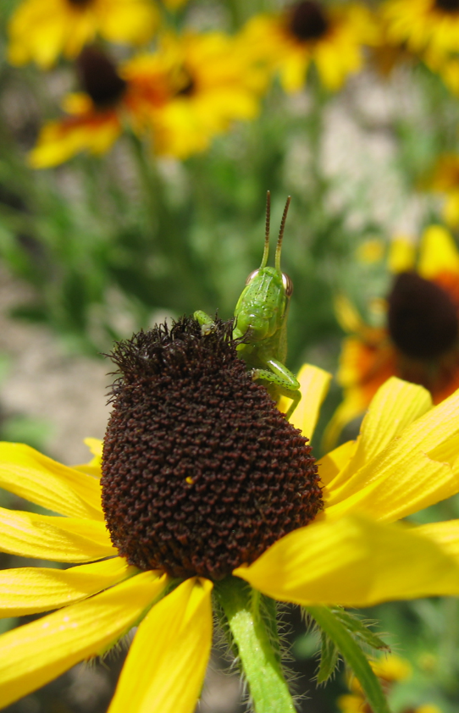
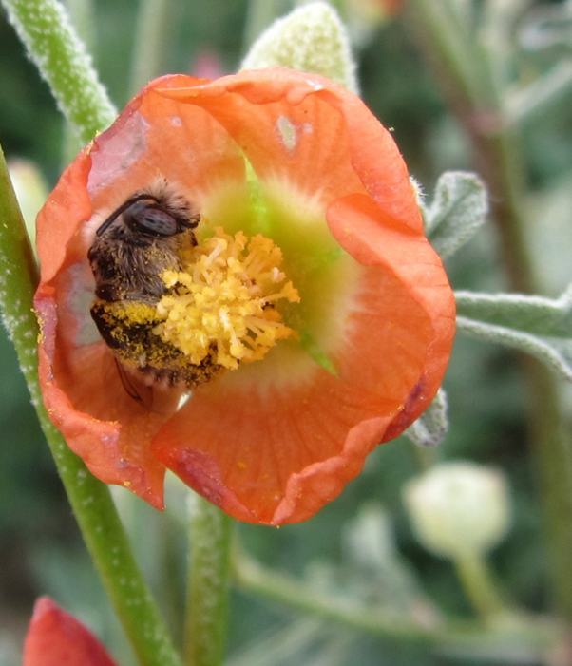
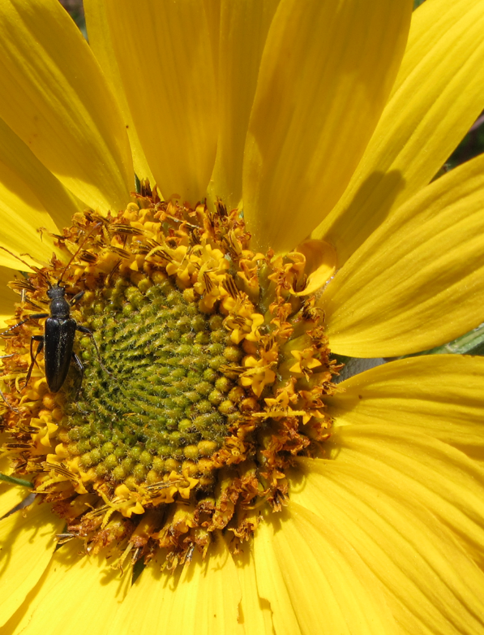
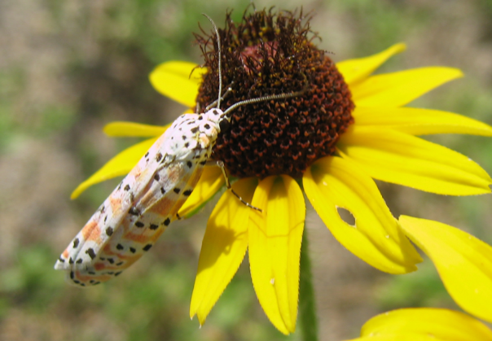
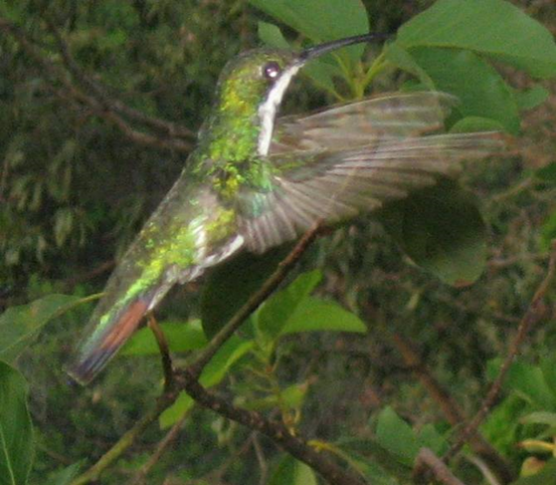
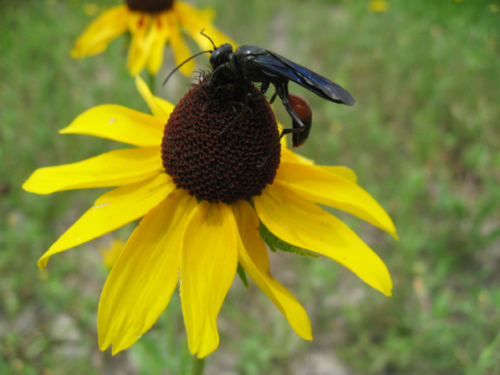
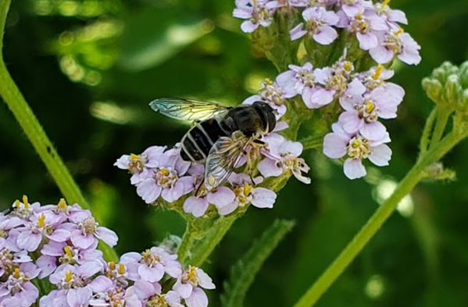
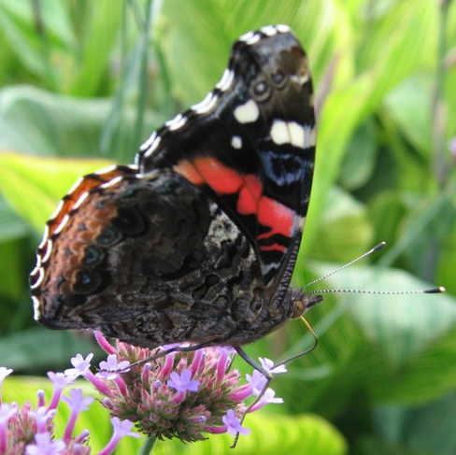
What are pollinators?
An organism that moves pollen from the anther of a flower to the stigma of another flower
Beetles
Wasps
Ants
Butterflies
Moths
Flies
Grasshoppers, crickets, and cockroaches (rarely, often accidental)
Birds
Mammals (mostly bats and not in WA)
Reptiles (very rare, not in WA)
Bees
Image(s)

Slide 4
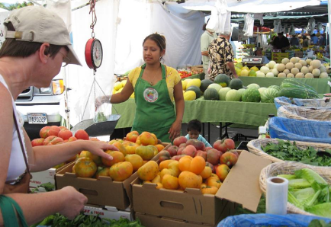
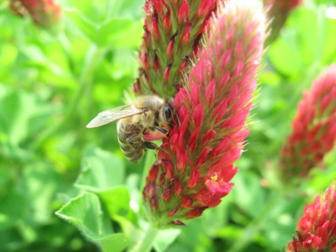
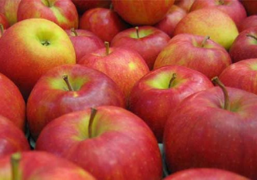
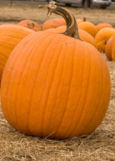
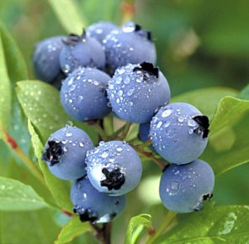
90% of flowering plant species require a biotic pollinator
Many pollinators are specialists and tightly linked to a genus or species of plant
75% of crop species rely to some degree on biotic pollinators
This has been estimated to represent a third of the human diet (Klein et al. 2007)

Slide 5
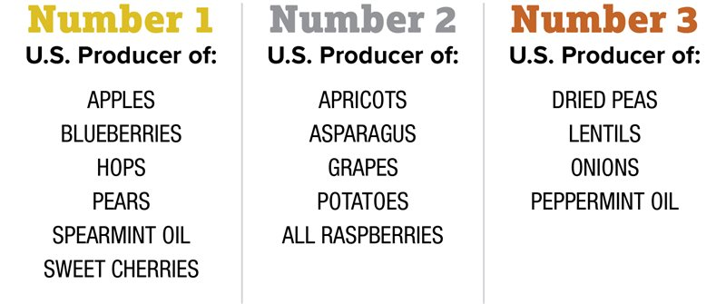
Washington in 2019

Slide 6
Washington in 2019 Without Pollinators

Slide 7
Not Normally Attractive to Pollinators

Slide 8
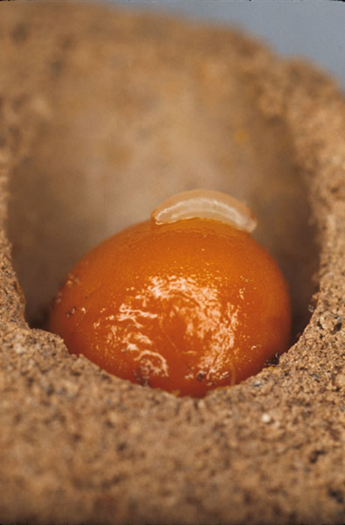
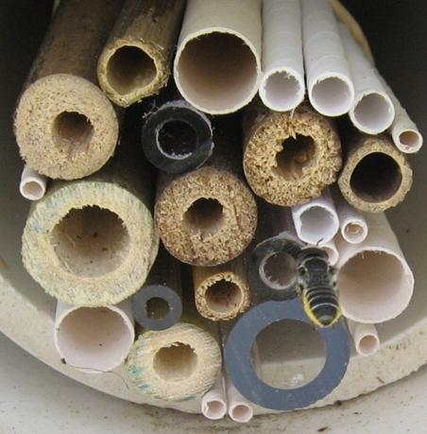
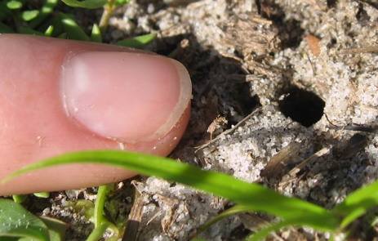
Bees
Image(s)
20,000 species of bees world wide
Over 500 species in Washington
Most bees are solitary, not social
70% of bees nest in the ground
30% nest in wood tunnels, hollow reeds or cavities
Large variance in size and color

Slide 9
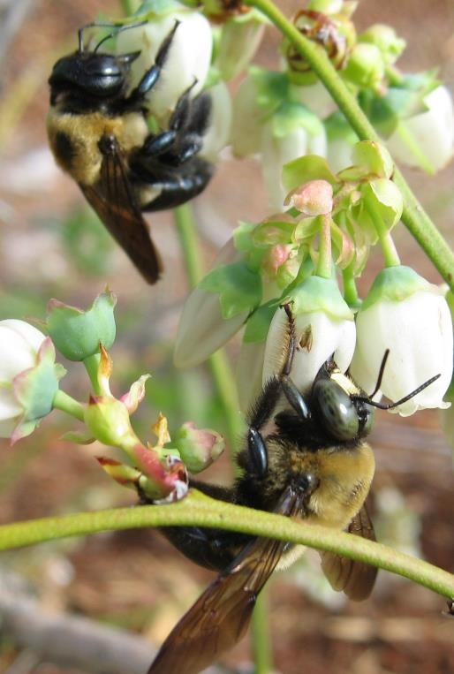
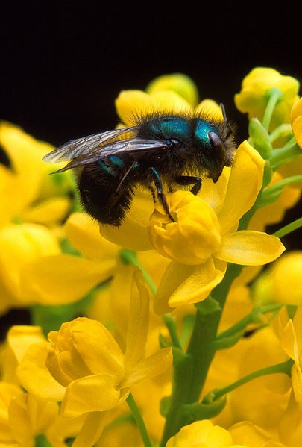
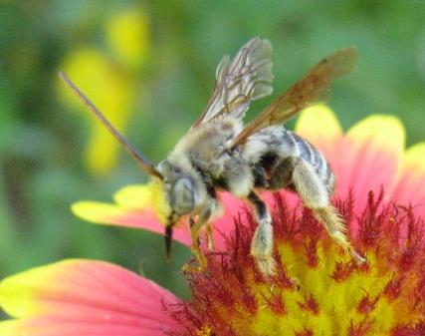
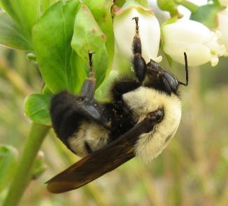
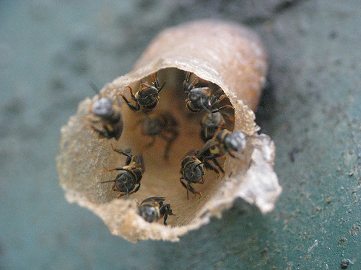
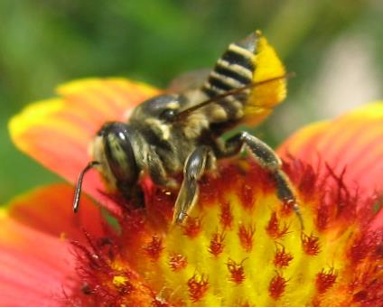
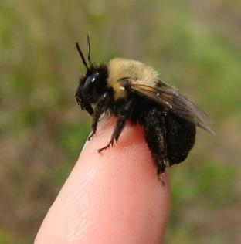
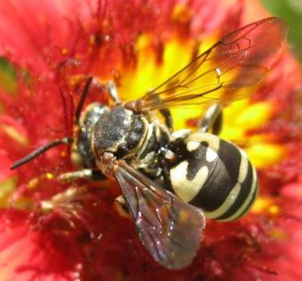
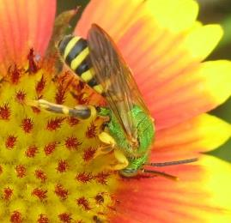
Some bees besides honey bees
Bumble bees
Carpenter bees
Mason bees
Leafcutter bees
Sweat bees
Long-horned bees
Stingless bees
Blueberry bee
Cuckoo bees

Slide 10
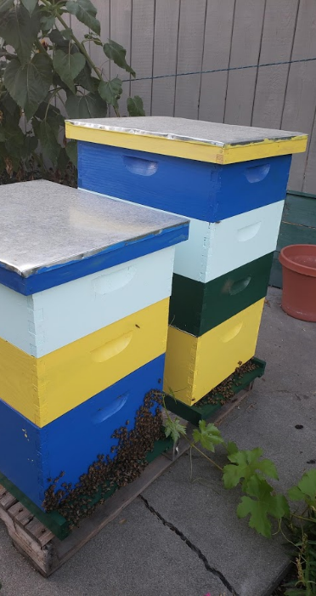
Once upon a time…
Image(s)
Honey bee colonies peaked in the US in 1950
Gradual decline since then, until Varroa mites (sharp decline in 1980s)
In 2006 Colony Collapse Disorder was recognized
In 2015 Obama called for a Pollinator Health Task Force, which released a report calling for (among other things) states to put together managed pollinator protection plans (MP3s) in 2016
Washington published theirs in 2018

Slide 11
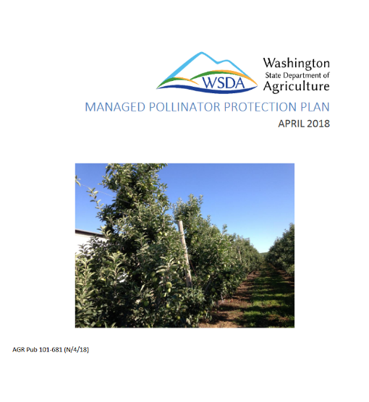
Washington State’s MP3
Image(s)
Managed Pollinator Protection Plans were part of a federal Pollinator Task Force recommendation that the EPA administers
11 pages long
Lays out current challenges pollinators face and programs that currently help, plus suggestions for further work
Also lays out Best Management Practices for growers, beekeepers, and pesticide applicators

Slide 12
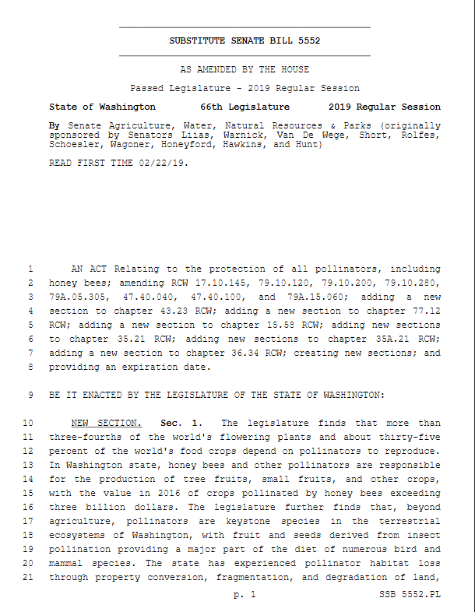
SSB 5552
Image(s)
Acknowledges importance of and threat to pollinators in Washington
Creates the WSDA Pollinator Program
Creates the Pollinator Health Task Force which must give their recommendations to the legislature by December 31, 2020.
Makes pollinators one of the priorities for all state land managing agencies
Allows community gardens in cities & towns

Slide 13
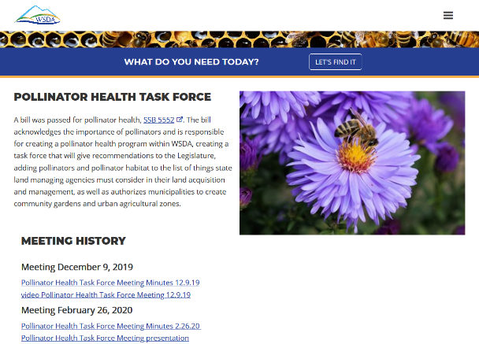
PHTF Beginnings
First meeting on December 9th
Begin bringing together stakeholders
Start work on a charter
Figure out a starting point for creating our recommendations (thanks Minnesota!)
5 subcommittees: Habitat, Pesticides, Education, Managed Pollinators, Research
Image(s)

Slide 14
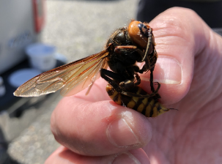
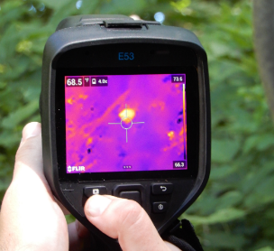
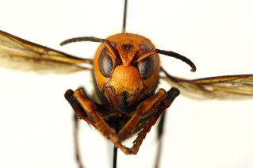
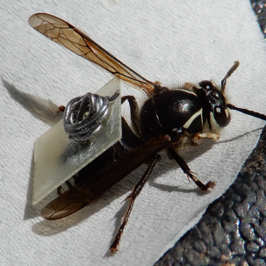
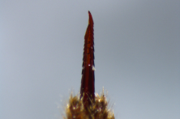
Asian Giant Hornet
Image
December 8th report of dead AGH
Site visit by WSDA staff on December 12th
Began planning a trapping program, outreach campaign, and hiring outreach coordinator
NY Times ‘Murder Hornet’ article came out May 2, 2020
AGH Outreach Coordinator started May 4, 2020…
Eradicated 1 nest in 2020 and 3 nests in 2021
Image
Image
Image
Image
Image
Technology test runs with native bald-faced hornets

Slide 15
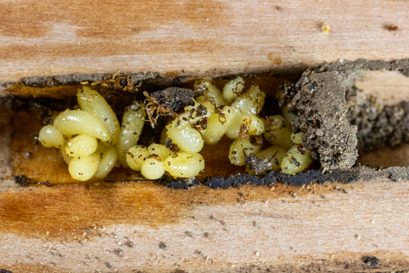
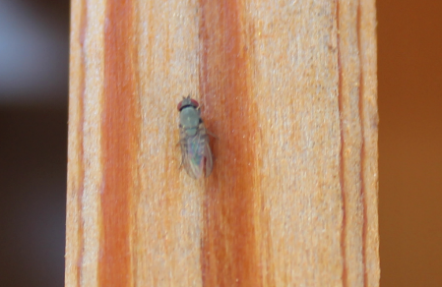
Houdini Fly
Image(s)
Dave Hunter of Crown Bees started finding strange maggots in their mason bees last year
They figured out the maggots were Houdini Fly at an Orchard Bee Association meeting
He reported them to WSU and WSDA on December 15
By February we had notified all Washington mason bee producers and started an outreach campaign
Kleptoparasite of mason bees (Osmia sp.)
Photos by Crown Bees

Slide 16
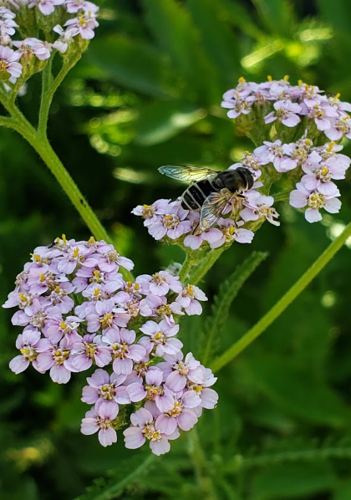
About the PHTF
The PHTF is comprised of a variety of stakeholders including
state agency representatives
pesticide applicator and producer representatives
conservation group representatives
agriculture representatives
tribal representatives
managed pollinator representatives
and other concerned members of the public.
We also have a number of advisory members, and most members have been active in soliciting opinions from a variety of experts and people involved in some way with pollinators or pollination.
Image
Image

Slide 17
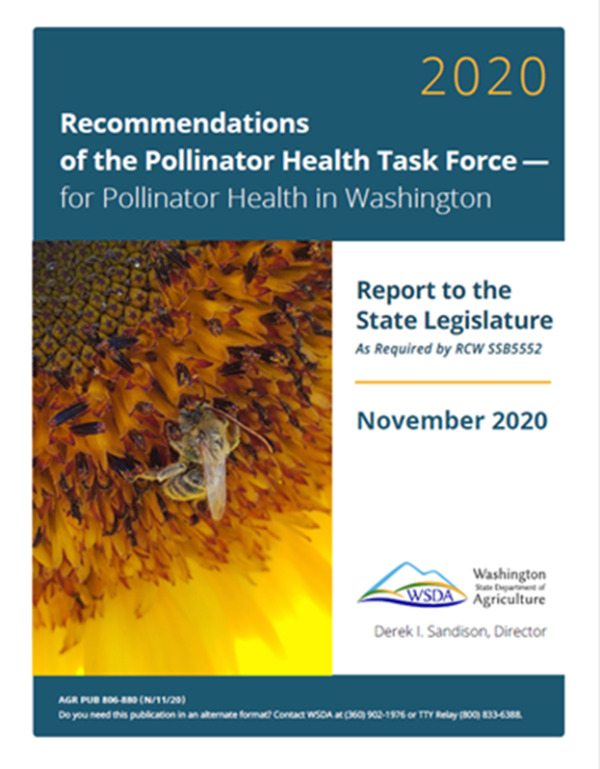
PHTF Recommendations
Image
Were sent to the legislature in November 2020
Can be found on our website: agr.wa.gov/pollinators
Image

Slide 18
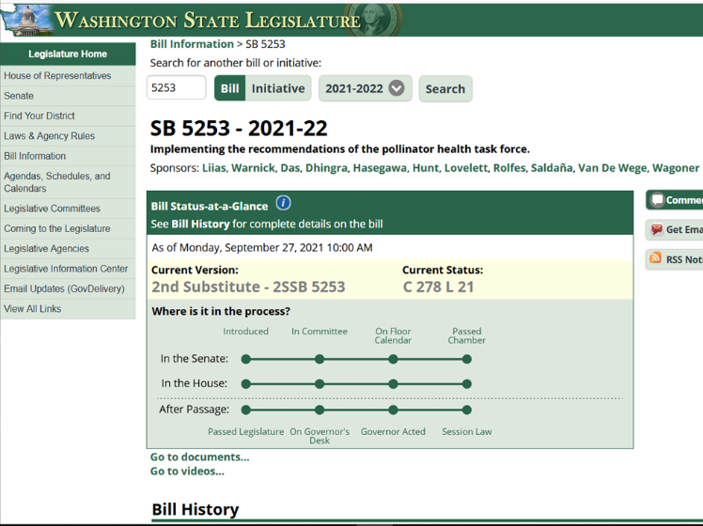
Pollinator Bill: SB 5253
Image
Implements many of the recommendations of the task force
Continues the task force to help with implementation
Affects WSDA, WDFW, WA-DOR, etc.
Passed in the Senate and House unanimously
Was signed into law and fully funded!!!!

Slide 19
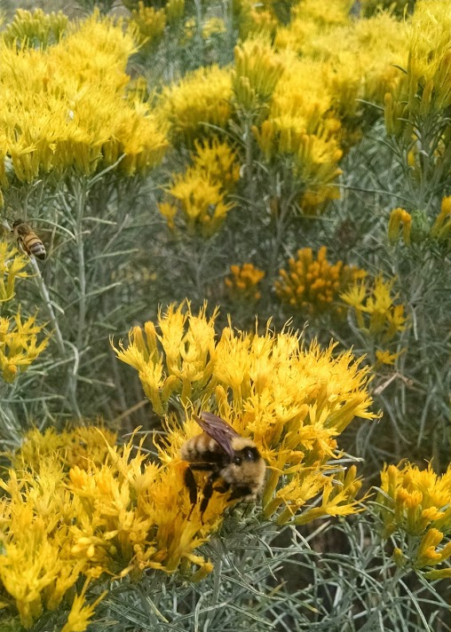
PHTF Implementation Plan
Image
An implementation plan for SB 5253 is due to the legislature on December 31, 2021.
It is currently in review. (Yay!)
A WSDA report on the risk of neonicotinoid pesticides to pollinators is also due to the legislature on December 31, 2021.
(It is also in review. Yay!)
Image

Slide 20
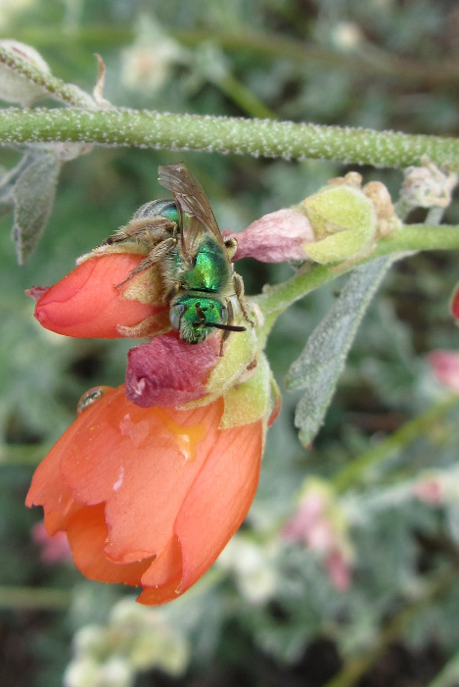
What did SB 5253 do?
Image
Continued the PHTF until at least 2024
WSDA + PHTF must complete implementation plan for SB 5253 by end of 2021 (including communication plan between beekeepers, growers, and pesticide applicators)
Made it illegal to use non-native bumble bees for open field ag
Established WSU pollinator extension and outreach program complete with a fully funded position
All public works projects that include landscaping must have at least 25% of that landscaping be pollinator habitat
Image

Slide 21
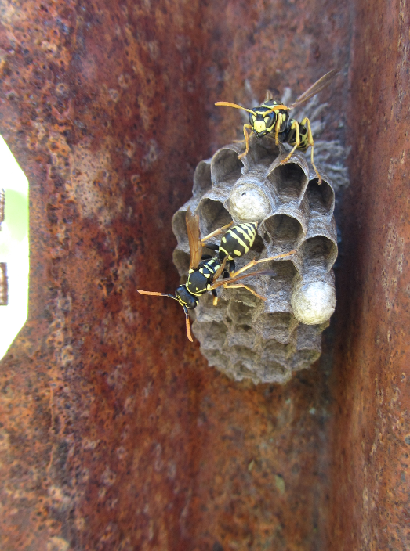
And… WSDA Pesticide Management Division must:
Image(s)
Continue and update pollinator protection training
Include pollinator protection in drift reduction training
Support WSU pesticide education programs
Coordinate with Katie and WSU on pesticide investigations and share findings
Update penalty matrix
Provide credits for pesticide courses focused on pollinator protection measures
Write a report on neonicotinoid pesticides and treated seeds with recommendations to mitigate risks to pollinators by end of 2021

Slide 22
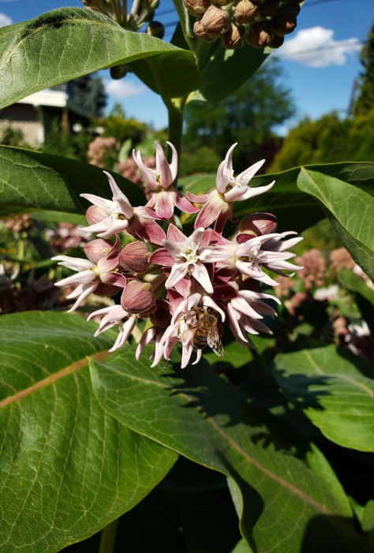
And… Some other agencies must…
Image
WDFW
Implement practices necessary to maintain pollinator habitat on department-owned and managed agricultural and grazing lands where practicable
Evaluate various restoration techniques with the goal of improving habitat for native pollinators
Update its riparian habitat recommendations to encourage development of pollinator habitat
Conservation Commission
Sustainable Farm and Fields grant program prioritize grant applications that concurrently create or maintain pollinator habitat
Develop a small grants program to educate residents about the value of habitat for both managed and native pollinators, and to provide the necessary technical and financial assistance and materials to create it
Image

Slide 23
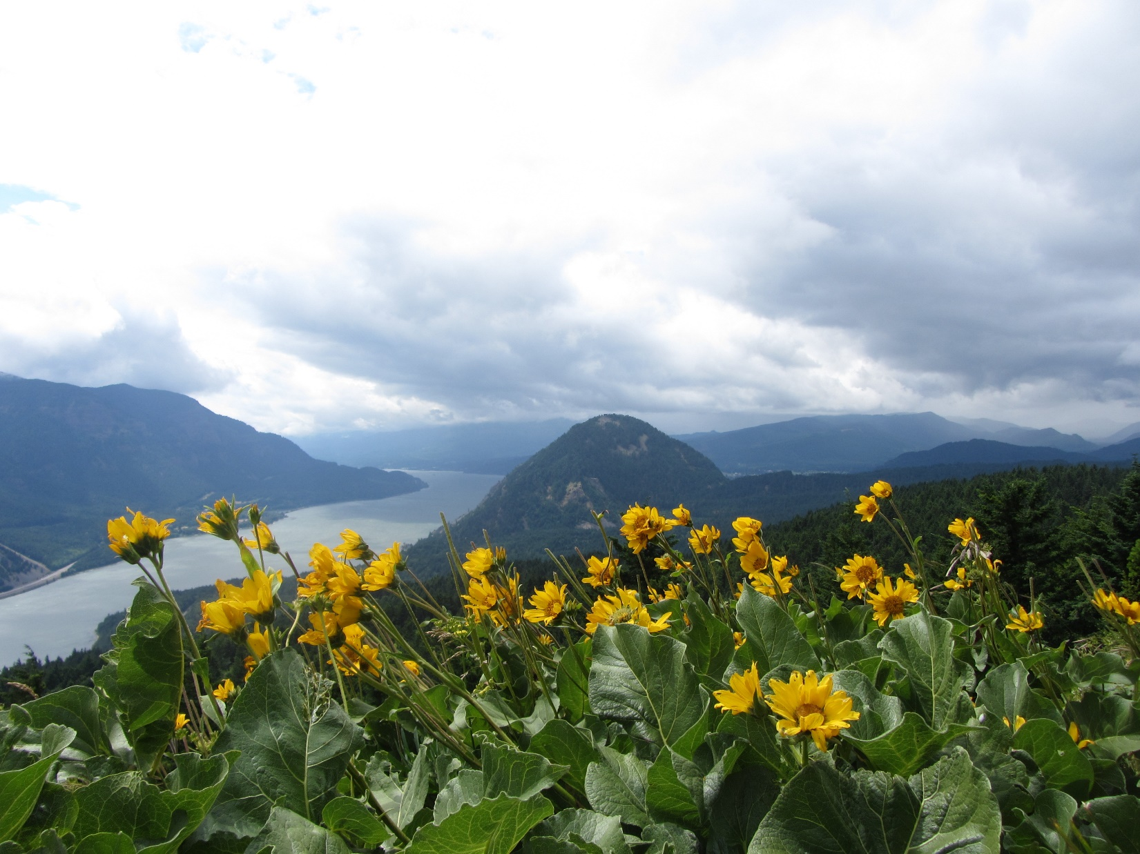
And… WSDA Pollinator Program must:
Review with WSU education needs and create education plan
Complete an analysis of critical impacts and needed best management practices for managed and wild pollinators
Document the bee species within the state and map their distributions
Report annually to noxious weed control board about pollinator issues
Provide materials about certification programs
Educate the public through plant nurseries
Survey registered beekeepers
Continue and maintain partnership with federal agencies and neighboring states
Increase the availability of pollinator-related resources on the department's website
Review guidelines on state-managed lands
In consultation with the DOR, review the open space taxation act
Develop a list of native forage plants
Work with WSDA PMD on pesticide investigations
Continue running the PHTF

Slide 24
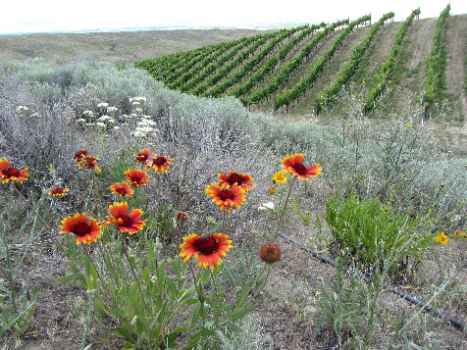
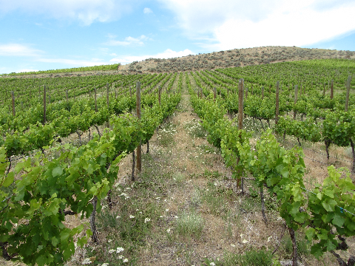
How can you help?
Image
Plant more flowers (preferably native plants)
Create habitat
Larval host plants
Nesting habitat (low/no till)
IPM
Don’t spray if you don’t have to
Use the ‘softest’ pesticide you can
DO NOT SPRAY when plants are in bloom
Mow before you spray
Communicate with your pest control and beekeepers
Avoid herbicide treatment during key blooms
Plant more flowers! (Trees and shrubs count!)
Image
Image

Slide 25
To learn more about pollinators and native plants for your area, check out:
The Xerces Society https://www.xerces.org/
The Audubon Society https://www.audubon.org/
The Pollinator Partnership https://www.pollinator.org/
The Native Plant Society https://www.wnps.org/
Your local Conservation District https://wadistricts.org/
The Woodland Park Zoo https://www.zoo.org/pollinator
The Washington Butterfly Association https://wabutterflyassoc.org/
The Washington Native Bee Society https://www.wanativebeesociety.org/

Slide 26
Questions?

Slide 27
Contact Us
WEB
EMAIL
agr.wa.gov
kbuckley@agr.wa.gov
TWITTER
FACEBOOK
@WSDAgov
http://tinyurl.com/WSDAFB
PHONE
YOUTUBE
360-480-0602
Youtube.com/user/WSDAgov
Images used in this presentation may not be reused without explicit written permission from the WSDA Communications Office

Slide 28
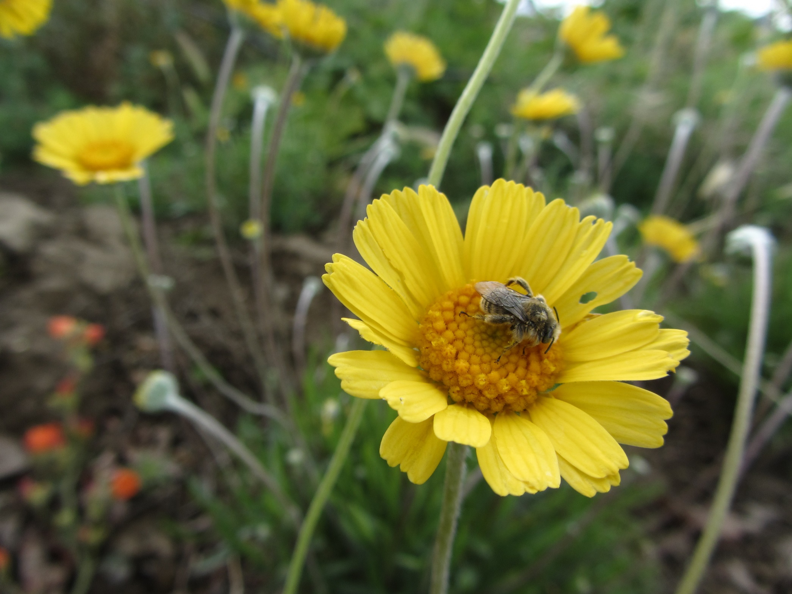
Thank You
Image
…the legislature intends by this act to initiate a concerted effort to protect and expand the habitat upon which pollinators depend… promoting practices to ensure sustainable, healthy populations of managed and native pollinators.

